Slide 1

House Sales Price Prediction
Machine Learning
Interim Report - 8th Sept 2019

Slide 2
TOC
Overview
Data Requirement
Data Preprocessing
Problems to solve
Data Description
Building Brain
Target audience
Hypothesis
Training Brain
Project objective
Data Correlation
Conclusion
Team

Slide 3
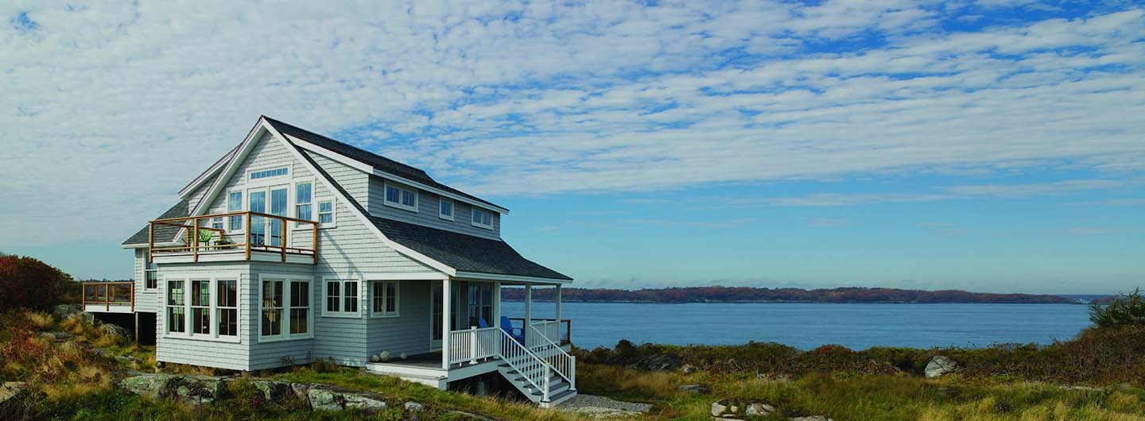
Overview
A house value is simply more than location and square footage. Like the features that make up a person, an educated party would want to know all aspects that give a house its value. For example, you want to sell a house and you don’t know the price which you can take — it can’t be too low or too high. To find house price you usually try to find similar properties in your neighbourhood and based on gathered data you will try to assess your house price.
So in this project we are trying to build a system which can help house buyer and seller to know house price provided basic input like area,location, number of rooms etc.

Slide 4
Problems to solve
Current Situation:
This current methodology of finding house price is by evaluating similar properties in neighbourhood and based on gathered data people will try to assess house price manually. It also involve price cap set by Government as well as cost of living of that location.So it require broker, buyer or seller to go through n number of features evaluate and predict the price.As it is manual process it high chance of mistake so house may be over priced or low priced and seller might find difficult to sell his house.
Opportunity for Improvement:
We see an opportunity here to automate this house price prediction using machine learning based systems which can consider all features and condition in account and predict price with high accuracy within fraction of seconds.This will help buyer to buy correct property according to his requirement without running after broker or other source.This will help seller to know best price of his house, so that he can sell his property easily.
We can see immense opportunity to build a system which can take input from all online broker website and compare price with our predicted price.

Slide 5



Target audience
Audience is very generic term, so it is very important if we define the group of people who will be using this system.
01 | Individual House Buyers/Broker
02 | Individual House Seller/Broker
03 | Online house Selling companies like Zillow,Magicbrick etc

Slide 6
Project objective
A system (Brain) which will automate the process of predicting house price given features and location of a house.It will use machine learning algorithm to evaluate past data and predict accordingly.

Slide 7
Nutrition for Brain - Data

Slide 8
Data Requirement
Information which is required to build this system is DATA. Data is bread and butter for machine learning system.It may break or out perform due to information/data which is provided to system.So it is very important to have correct and meaningful data.
We need at least last 2 year data with description/feature of house, location and price.As houses will be very old so it is important to have data how many times it got renovated as well as how many times it got sold.We need to check if government or other authority has provided any rating depending condition of house.
Source:
We have targeted 2 government authorities for getting data one is Registrar Office and the other is DMC(for getting house condition and quality).We have taken data from Mercer Island, United States of America.
Challenges:
As still it is manual process for data feeding so there are high chances of mistake or missing information.
These authorities will have data with respect to other influencing factor like income and economic growth.So we need to live with that.
Size:
We got sample size of around 21000 records from both the authorities for 2 years.

Slide 9
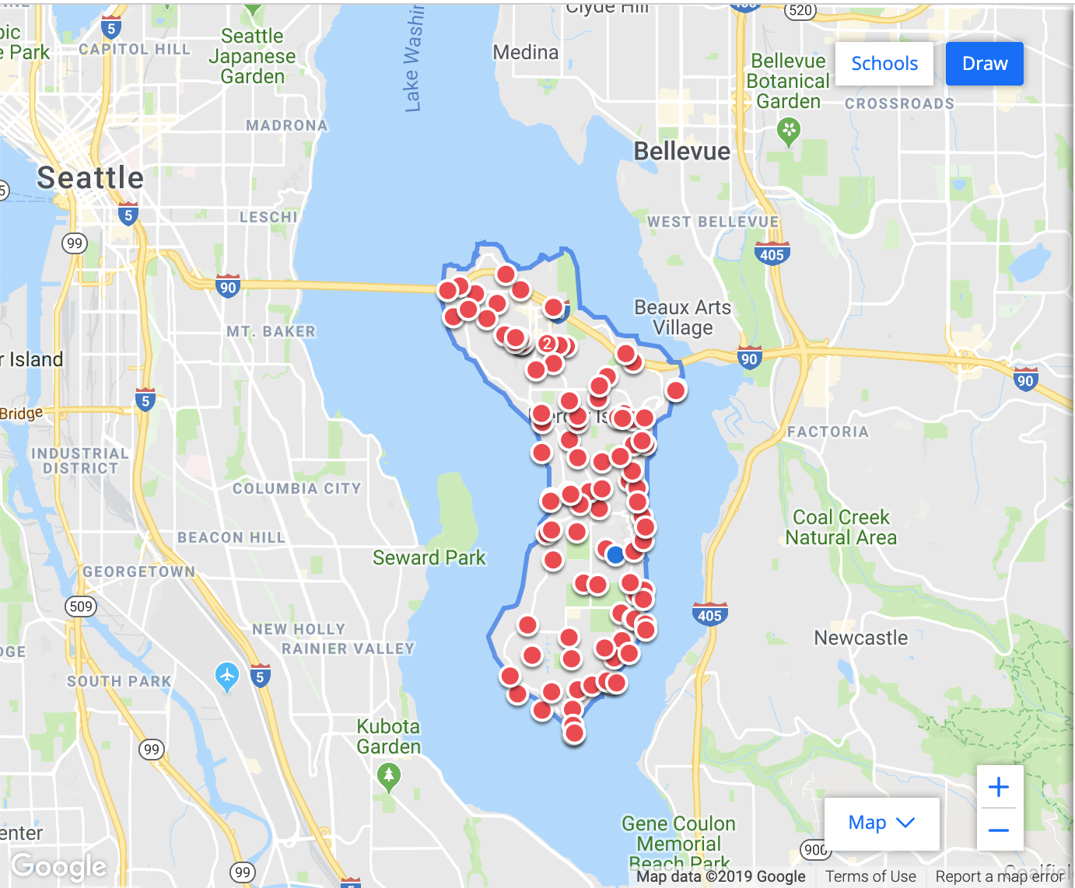
Data Description
As we got data from 2 different authorities we clubbed them together and created one dataset.
Data set contains house sales price for house sold in Mercer Island, United States of America between 2014 and 2015.
Mercer Island is in King Country. King Country is the most populous country in Washington and is included in the Seattle-Tacoma-Bellevue metropolitan statistical area.The country is considered the 13th most populous country in United States
There are 21,613 observation in the dataset
There are total 23 attributes,22 are independent and 1 i.e. price is target attribute.We will be using these attributes for further analysis to check what all attributes we can keep for model building.

Slide 10
Data Description
Attribute | Skewness | Corr(Price)
living_measure | 1.472 | 0.702
quality | 0.771 | 0.667
ceil_measure | 1.447 | 0.606
living_measure15 | 1.108 | 0.585
furnished | 1.526 | 0.566
room_bath | 0.511 | 0.525
We found following parameters are strongly correlated with price
living_measure is square footage of the home.
Quality is grade given to the housing unit, based on grading system
Ceil_measure is square footage of house apart from basement
Living_messure15 is living room area in 2015
Furnished is weather house is having furniture or not.
Room_bath is number of bathrooms in a house

Slide 11
Data Description
Attribute | Skewness | Corr(Price)
sight | 3.396 | 0.397
basement | 1.578 | 0.324
room_bed | 1.974 | 0.308
lat | -0.485 | 0.307
coast | 11.385 | 0.266
ceil | 0.616 | 0.257
We found following parameters are having weak correlation with price
sight is has been viewed or not.
basement is square footage of the basement
room_bed is number of bedrooms in a house
lat is latitude coordinate
coast is house which has a view to a waterfront
ceil is total floors (levels) in a house

Slide 12
Data Description
Attribute | Skewness | Corr(Price)
yr_renovated | 4.549 | 0.126
total_area | 12.956 | 0.105
lot_measure | 13.060 | 0.090
lot_measure15 | 9.507 | 0.082
yr_built | -0.470 | 0.054
condition | 1.033 | 0.036
long | 0.885 | 0.022
zipcode | 0.406 | -0.053
We found following parameters with no correlation with price
yr_renovated is year when house was renovated
total_area is measure of both living and lot
lot_measure is square footage of the lot
lot_measure15 is square footage of the lot area in 2015
yr_built is year when house was built
condition is how good the condition is (Overall)
long is longitude coordinate
zipcode is zip code of house
It will be interesting to check what coefficient values these variables can have while building Linear regression model

Slide 13
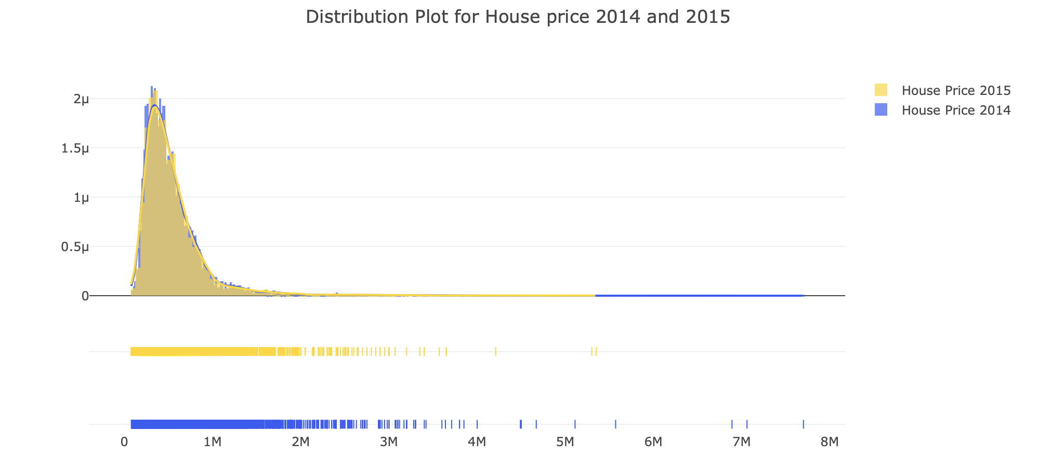
Data Distribution - Price
We see data is right skewed for Price
We have less entries for year 2015 compared to 2014.
No visible difference between central tendency of house price in the year 2014 and 2015.

Slide 14
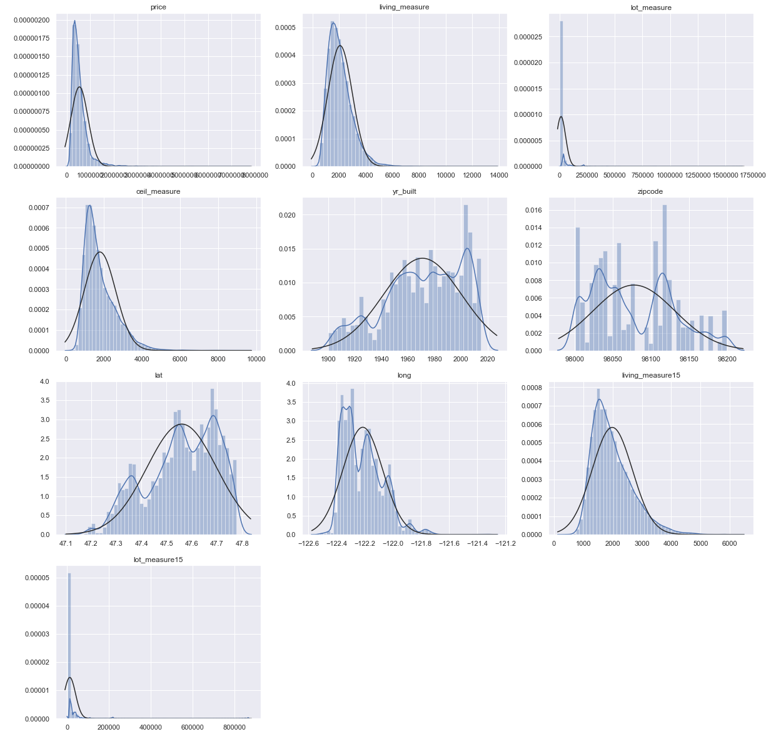
Data Distribution - Other
We see distribution for these variables is not normally distributed.
Most of the variable are right skewed
Living_measure , living_measure15 and ceil_measure are near to normal but right skewed with skewness value as 0.72, 0.585 and 0.602.
As expected we can see lat and long are having 2 to 3 gaussian, so these attributes are good get categories or binned.
Lot_messaue and lot_meassure15 are right skewed and might be with outliers.
We have used log transformation technique to address the issue of skewness.

Slide 15
Hypothesis
Our aim is to predict house price for given attributes and for that we have to prove there exists a linear relation between House Price and independent attributes. We will be taking help of OLS model and Linear regression model to measure R-value or Pearson coefficient.
We then hypothesize as follow :-
Null Hypothesis:
No relation exist between Independent variables and House Price .
H0 : R-value or Pearson value < 0.70 in magnitude
Alternate Hypothesis:
Linear relation exist between Independent variables and House Price
Ha : R-value or Pearson value >= 0.70 in magnitude
Notes:
Note : we have decided to go with 0.70 R- value as a threshold.

Slide 16
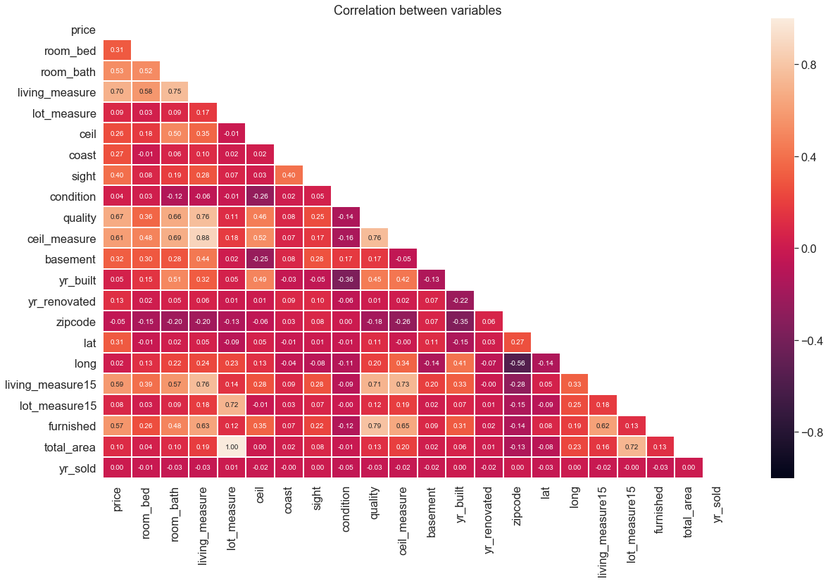
Data Correlation - HeatMap

Slide 17
Data Correlation
In our opinion, this heatmap is the best way to get a quick overview of showing relationships between independent variable and target variable.
At first sight, there are two squares that get our attention. The first one refers to the 'lot_messaure' and 'total_area' variables, and the second one refers to the 'living_measure' and 'ceil_mesaure' variables. Both cases show how significant the correlation is between these variables. Actually, this correlation is so strong that it can indicate a situation of multicollinearity. If we think about these variables, we can conclude that they give almost the same information so multicollinearity really occurs. Heatmaps are great to detect this kind of situations and in problems dominated by feature selection, like ours, they are an essential tool.
Another thing that got our attention was the 'price' correlations. As we got in description, we can see our well-known 'living_measure', 'Quality', and 'ceil_mesaure' saying a big 'Hi!', but we can also see many other variables that should be taken into account.

Slide 18
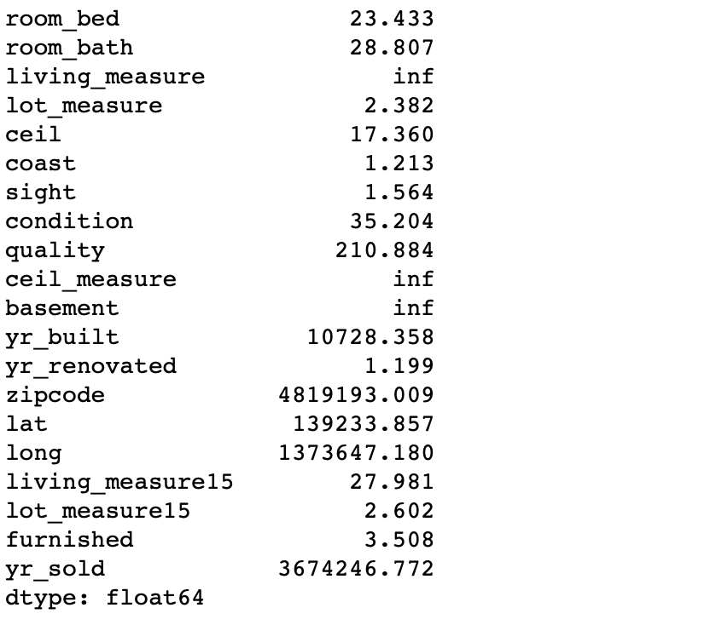
Data Correlation - VIF
A VIF of over 10 for some feature indicates that over 90\% of the variance in that feature is explained by the remaining features. Over 100 indicates over 99\%.
There are only three Feature whose VIF value is INF , So we need to perform a PCA on these three variables.

Slide 19
Data Preprocessing - Missing Value
Important questions when thinking about missing data:
How prevalent is the missing data?
Is missing data random or does it have a pattern?
The answer to these questions is important for practical reasons because missing data can imply a reduction of the sample size. This can prevent us from proceeding with the analysis. Moreover, from a substantive perspective, we need to ensure that the missing data process is not biased and hiding an inconvenient truth.
room_bed with 13 zero seems missing value,we can not treat as outlier as it can be community hall.
room_bath is having 10 zero values seems missing value,we can not treat as outlier as it can be community hall.
coast is having 21450 zero values,but we can not take it as missing value, as there can house without coast facing.
sight is having 21450 zero values,but we can not take it as missing value, as there can house which are not visited once.
basement is having 21450 zero values,but we can not take it as missing value,as there can house without basement.Basement in US prefered.
yr_renovated is having 21450 zero values,but we can not take it as missing value,as there can house which are not enovated once and got soled
furnished is having 21450 zero values,but we can not take it as missing value,as there can house which are not furnished and got sold.

Slide 20
Data Preprocessing - Outlier
We ran outlier check and found that below attributes contain high number of outlier.
Attribute | No of Outlier
lot_measure | 2425
lot_measure15 | 2194
total_area | 2419

Slide 21
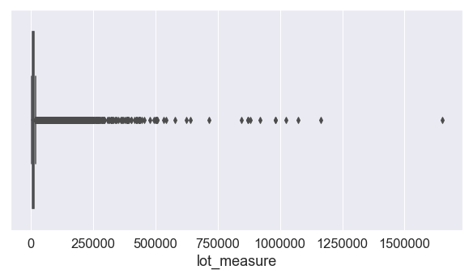
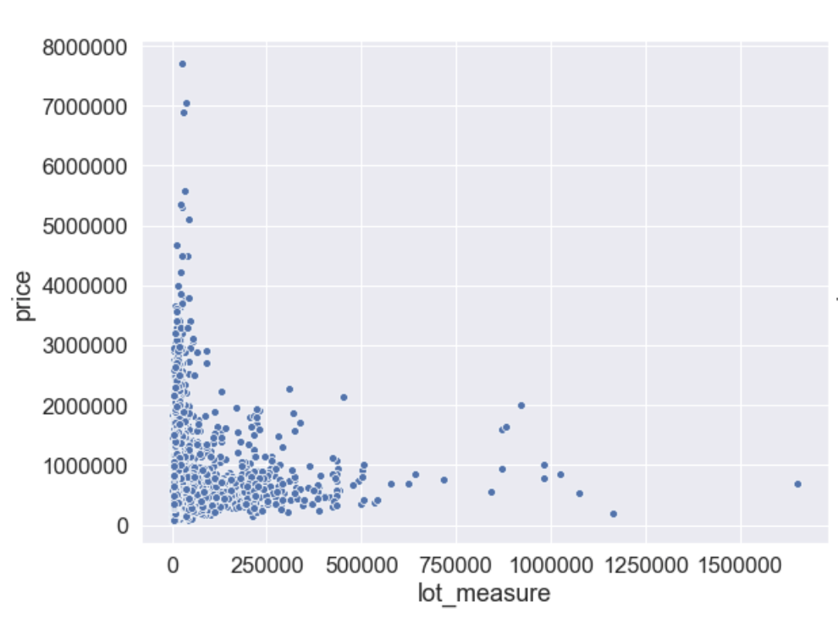
Data Preprocessing - Outlier Analysis
The one value with bigger 'lot_measure' seem strange and it is not following the crowd. We can speculate why this is happening. Maybe they refer to old house and that could explain the low price. Therefore, we'll not define them as outliers.

Slide 22
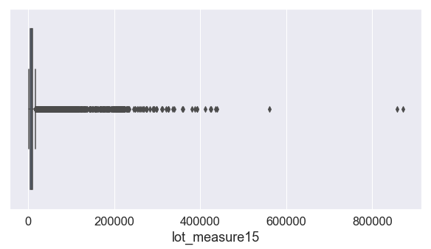
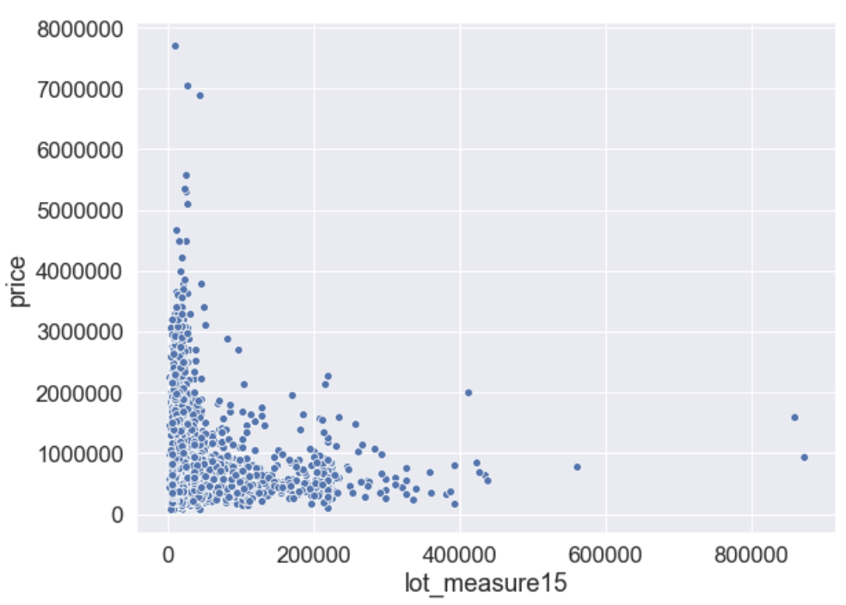
Data Preprocessing - Outlier Analysis
The one value with bigger 'lot_measure15' seem strange and it is not following the crowd. We can speculate why this is happening. Maybe they refer to old house and that could explain the low price. Therefore, we'll not define them as outliers.

Slide 23
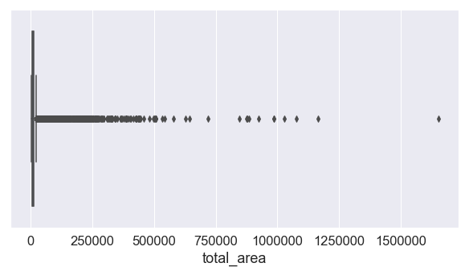
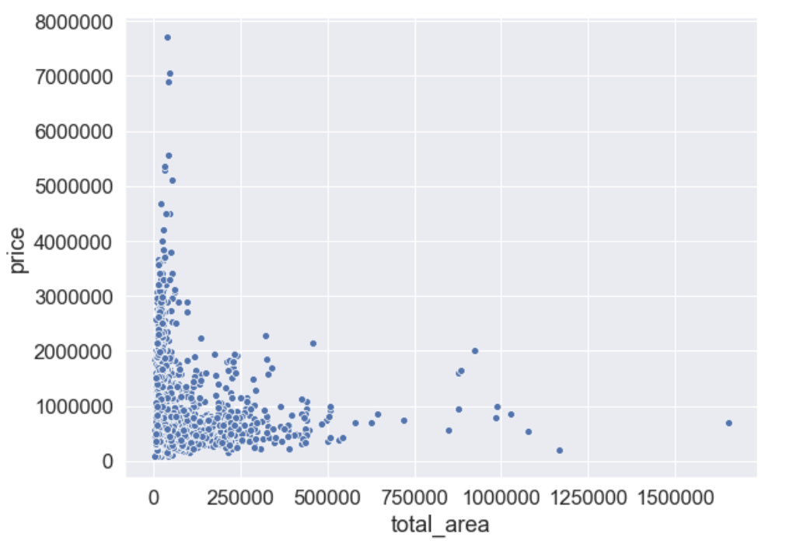
Data Preprocessing - Outlier Analysis
The one value with bigger 'total_area' seem strange and it is not following the crowd. We can speculate why this is happening. Maybe they refer to old house and that could explain the low price. Therefore, we'll not define them as outliers.

Slide 24
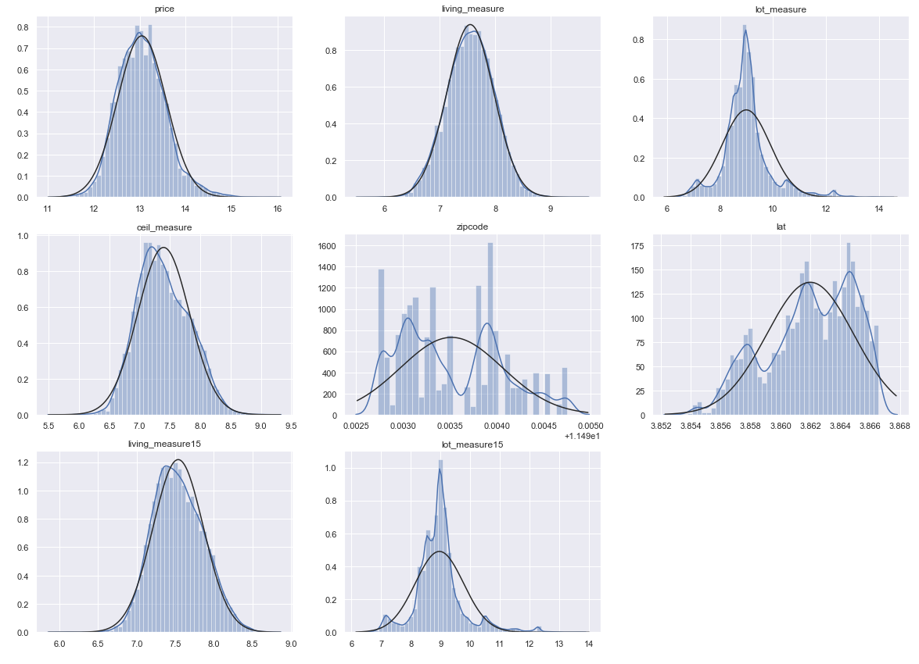
Data Preprocessing - Normalisation/Scaling
As we know normalisation is required for model,we performed transformation using log to bring distribution in normalise state

Slide 25
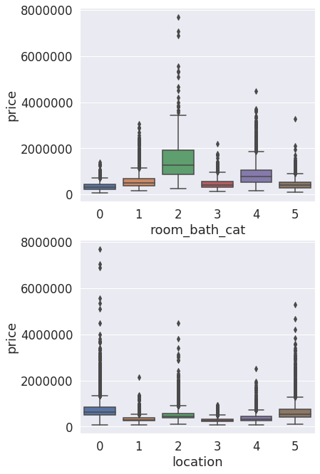
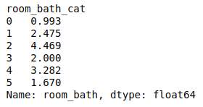
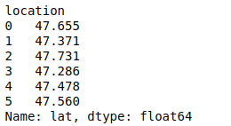
Data Preprocessing - Feature Engineering
During feature analysis we found that lat is having good relation with price and having 2 to 3 gusians. We know that house value varies with respect to location,so we decided to create binned/grouped on this attributes.
We choose not to use zipcode, dayhours and total_area as there are other variables which are giving same information.
We also removed cid because it was just an id attribute.
We performed feature selection by looking at the correlation percentage with each attributes with price.
We performed PCA on highly correlated variables,but there were no improvement on model performance.
We have chosen room_bath to grouped/binned and found accuracy got increased.Will evaluate further in next milestone.

Slide 26
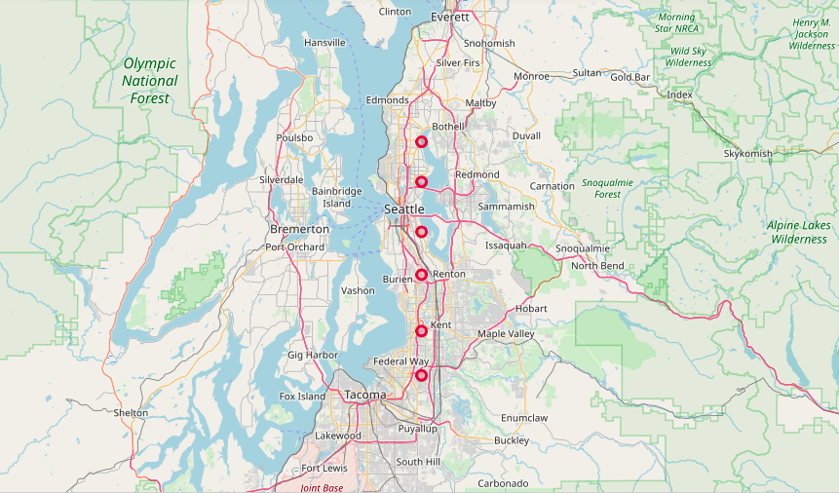
Data Preprocessing - Feature Engineering
Below 6 latitude values cover different locations
in Seattle and is very important feature.

Slide 27
Building Brain

Slide 28
Model Building - Data Preparation
Before evaluating different model it is important split data into 3 different section i.e. train, validate and test.We have taken 70% data for training and 15% each for validate and test.For identifying appropriate model we will keep test and validate as one group and split further while doing model fine tuning.
Group | Shape
Train | Rows: 15129 Column: 21
Test | Rows: 6484 Column: 21

Slide 29
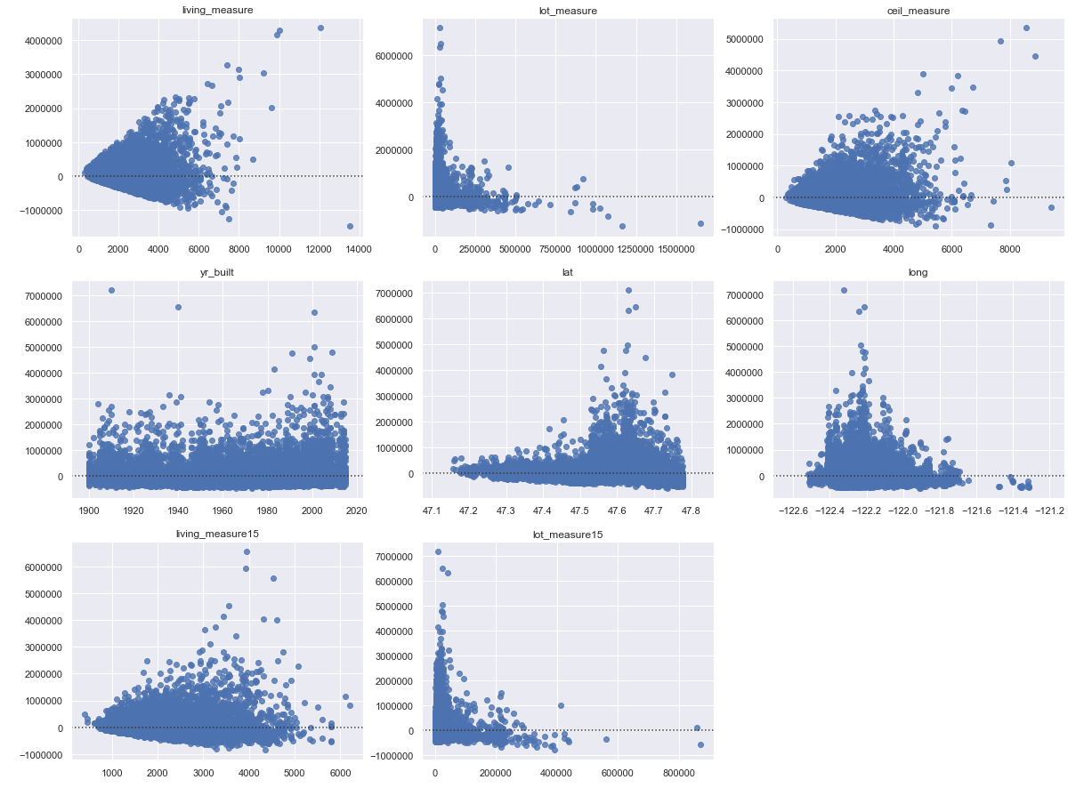
Model Building - Residual plot analysis
As we have seen distribution we can say linear regression would be best model for predicting price.But let’s evaluate using residual plot. If the points in a residual plot are randomly dispersed around the horizontal axis, a linear regression model is appropriate for the data otherwise a non-linear mode is more appropriate.
We see funnel shaped pattern for living measure and Ceil measure and there is a scope for improvement
For rest other variables we don’t see clear patterns and can confidently say that these variables are good predictors for Price and best fit for linear regression model.
Residual plot for most of the features is randomly dispersed around horizontal axis hence Linear regression model is appropriate for this data

Slide 30
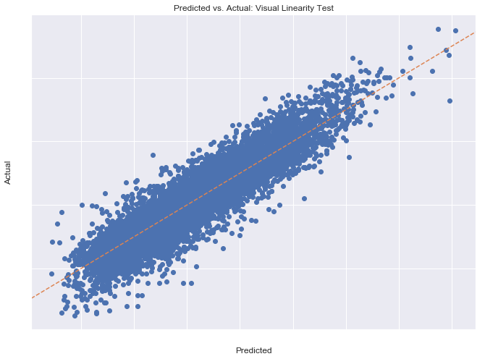
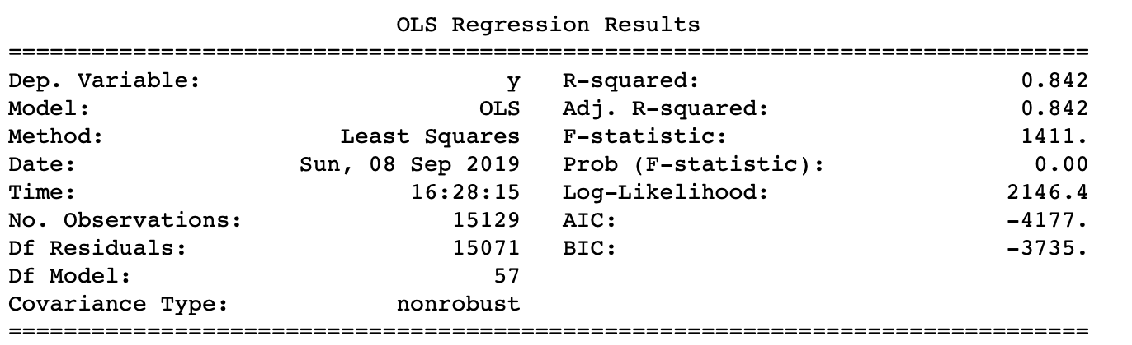
Model Building - Linear Regression Model
We evaluated price prediction on Linear Regression model and it shown R-value close to 0.84, i.e. this model is able to explain variance at great extent.We can further improve the R-value by fine tuning hyper parameter.

Slide 31
Model Building - Linear Regression Model Analysis
We evaluated price prediction on Linear Regression model and it shows R-value close to 0.84, i.e. this model is able to explain variance at great extent which is close to 1.
Hence we can reject null hypothesis and can safely accept there exists relationship between Independent variables and House price.
We can further improve the R-value by using advanced algorithms and fine tuning hyper parameters.

Slide 32
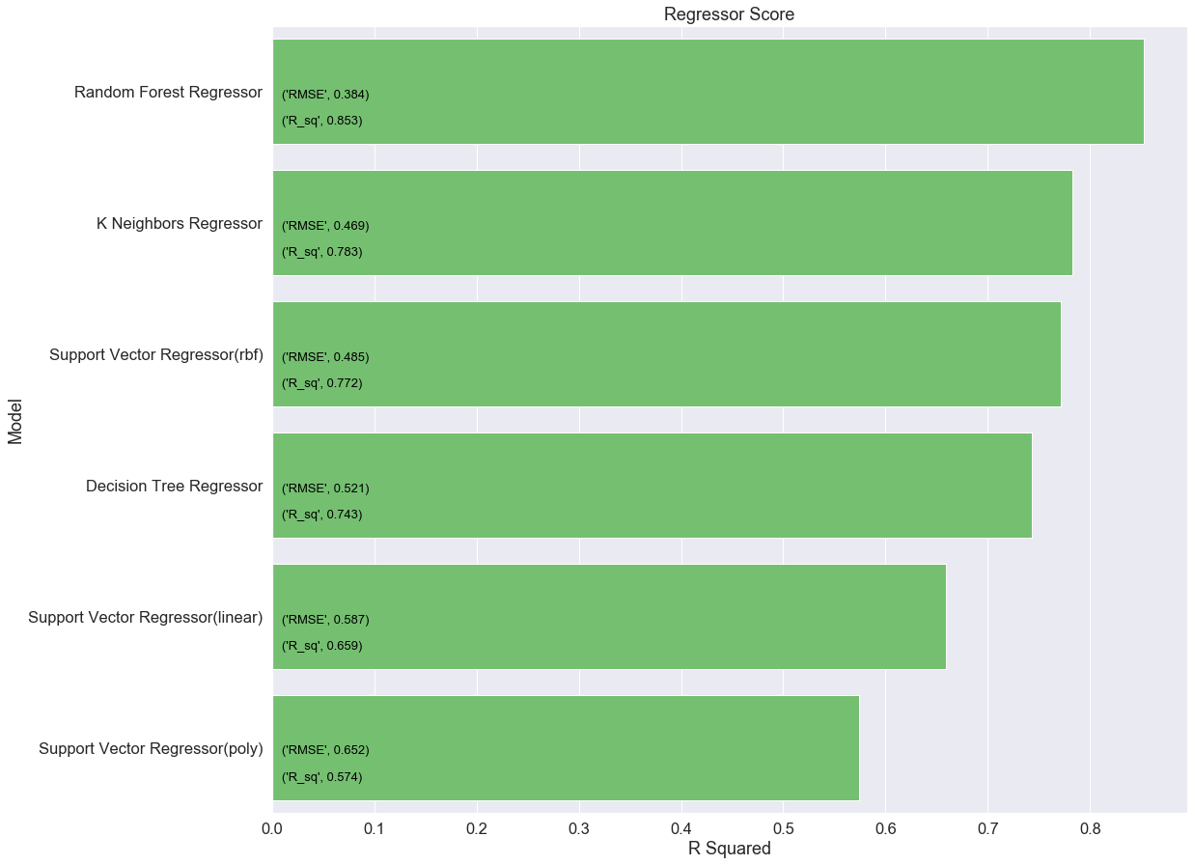
Model Building - Other Models
We evaluated other models and found that Random Forest Regressor and KNN Regressor out performed in comparison with other regressing models.

Slide 33
Train & Test Brain

Slide 34
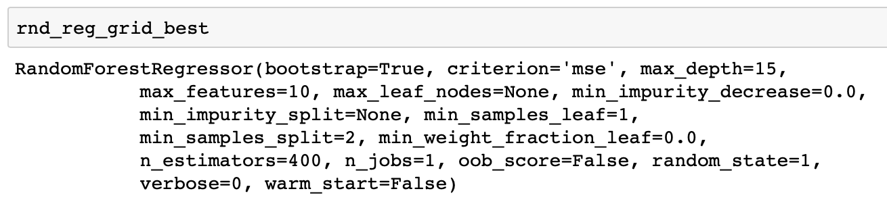
Random Forest - Fine Tuning
We have used techniques like Gridsearch/RandomSearch, cross validation and hyperparameter tuning to find the right set of parameters with values for which model can give best performance
Score Before Tuning:
85.3
Score After Tuning:
89.0
So, we can see considerable amount of increase in performance after tuning parameter.

Slide 35
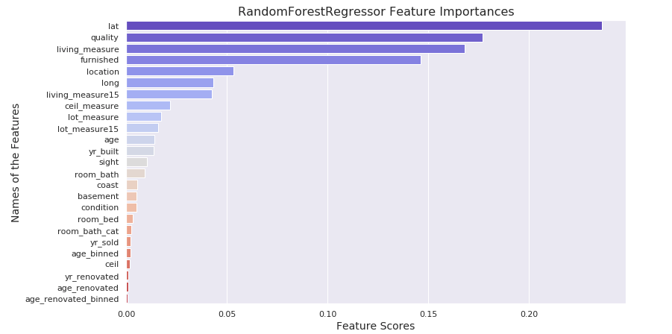
Random Forest - Feature Importance
We have used feature importance technique to find significance of each parameter.
We have taken decision to remove those feature which are having importance below 0.0090.
Features which are removed:
coast
basement
condition
room_bed
room_bath_cat
yr_sold
Age_binned
ceil
yr_renovated
age_renovated
age_renovated_binned

Slide 36
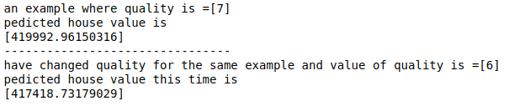
Random Forest - Price Prediction
To simulate the prediction of price in production, we have done analysis on Quality feature. We have taken feature Quality and varied its value by keeping all other values same and found difference in house price by 2.5k.This is as per our expectation, according to coreleation we got during EDA.

Slide 37
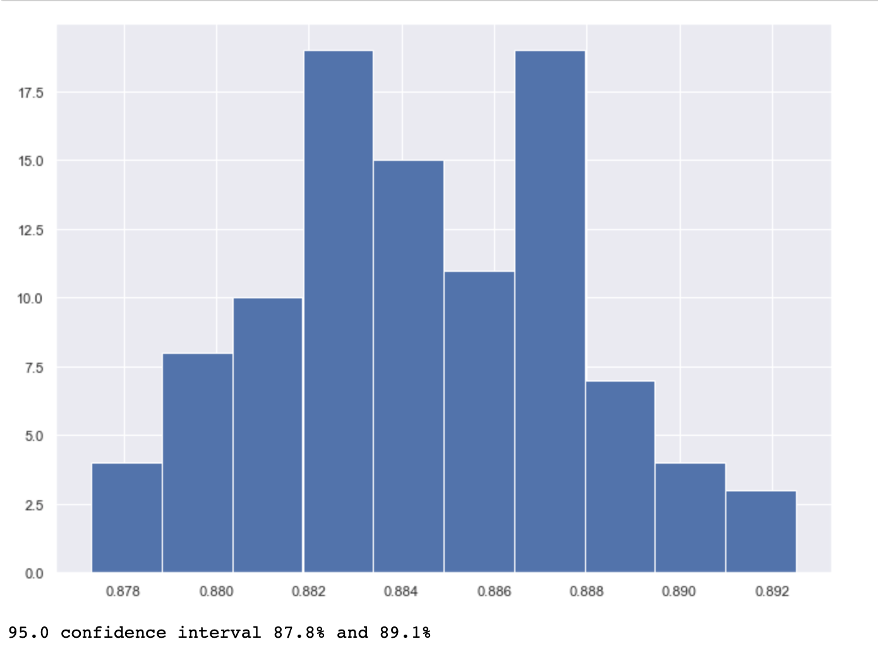
Random Forest - Confidence Interval
Confidence intervals are a way of quantifying the uncertainty of an estimate. It is an interval statistic used to quantify the uncertainty on an estimate.
After running the model iteratively on 100 sample. We found a smooth normal curve depicting accuracy of the model . The reported accuracy of the model was 87.8% to 89.1% at the 95% confidence level.

Slide 38
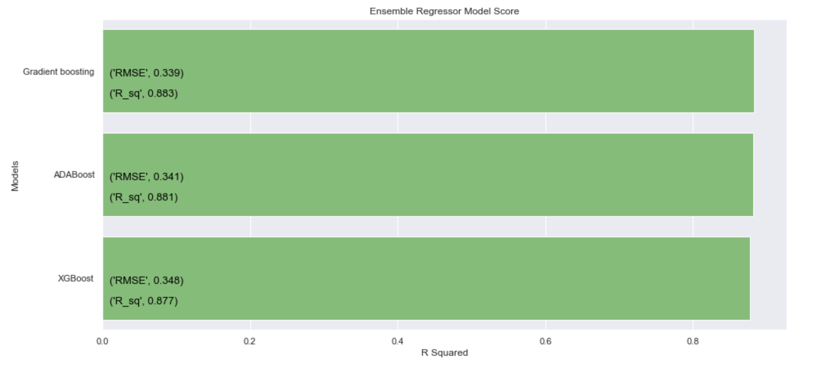
Model Evaluation - Regression Metric
We have evaluated other non parametric algorithms.
Gradient boosting
XGBoost
ADABoost
XGBoost out perform with 91.1 score.
Random Forest also performs near to XGBoost,so we will go with the Random forest as it is easier to explain and fine tune parameters with hardware limitation.

Slide 39
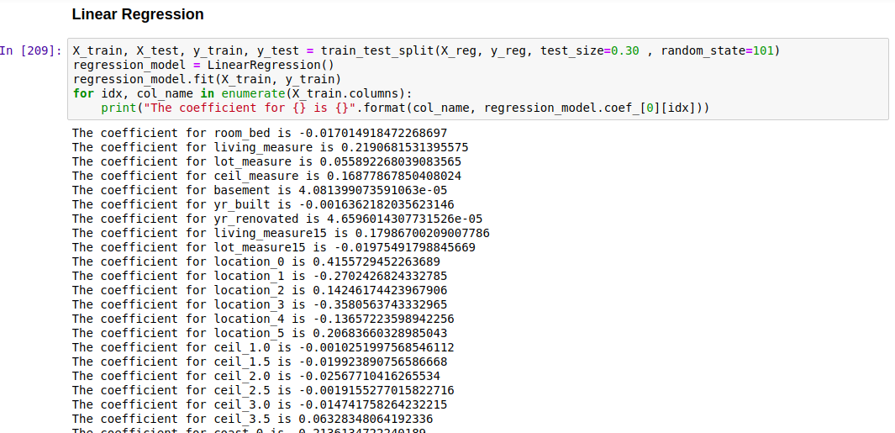
Linear Regression Model - Feature Importance
From the parametric set of algorithms we chose Linear Regression to be our one of the final model.
As we know in Linear regression, features with highest coefficient values influence the outcome of prediction.
Lets move to next slide to see how House price value varies when we change unit value of one of the important feature.

Slide 40
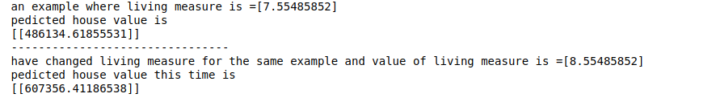
Linear Regression Model - Price Prediction
From the previous slide we saw coefficient for Living Measure carries value of 0.22 and lets check its contribution in predicting the house price when increased the value by 1 unit and keeping value of rest other features same
We have observed around 24 percent increase which is closer to what we have in coefficient 0.22 i.e. near to expected 22% impact on house price.

Slide 41
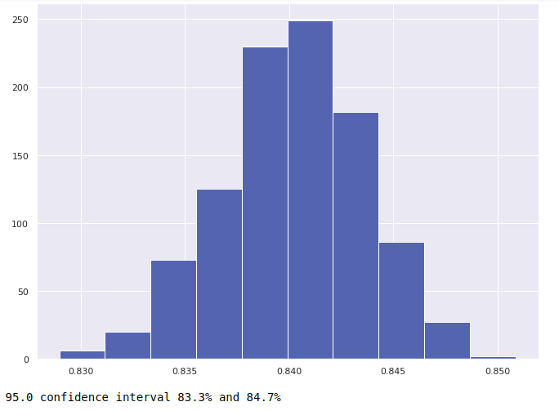
Linear Regression Model - Confidence Interval
Confidence intervals are a way of quantifying the uncertainty of an estimate. It is an interval statistic used to quantify the uncertainty on an estimate.
After running the model iteratively on 1000 samples. We found a smooth normal curve depicting accuracy of the model . The reported accuracy of the model is 83.3% to 84.7% at the 95% confidence level.

Slide 42
Conclusion

Slide 43
Conclusion
We have done our analysis on various parametric and non-parametric algorithms and by considering below points
Performance and Hardware Limitations
While evaluating and Fine Tuning which model had shorter training time.
Which model was easy to interpret
Which model would be Easier to implement in production
Reduced risk of data errors during model use
We have concluded that we will keep both one parametric and one non parametric models in production. These models are
Random Forest Regressor (with 95% confidence interval accuracy range is between 88 to 89)
Linear Regressor (with 95% confidence interval accuracy range is between 83 to 84)
Random Forest Model will be using 14 parameter whereas Linear Regression Model will be using all 25 parameters.
We will keep monitoring deviation (i.e. RMSE) from actual prediction and its root cause and will keep fine tuning our model time to time for better result.

Slide 44
Model Building - Notebook
We have shared Jupyter notebook as a separate file for a reference.

Slide 45







Team - G4
We have very enthused and dedicated team across the globe, headed by Ashish Vyas as our mentor, who helped and guided us in every stage of this project

Slide 46
Thank you.
Q&A

